Slide 1





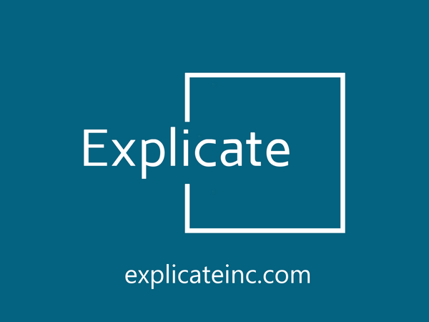

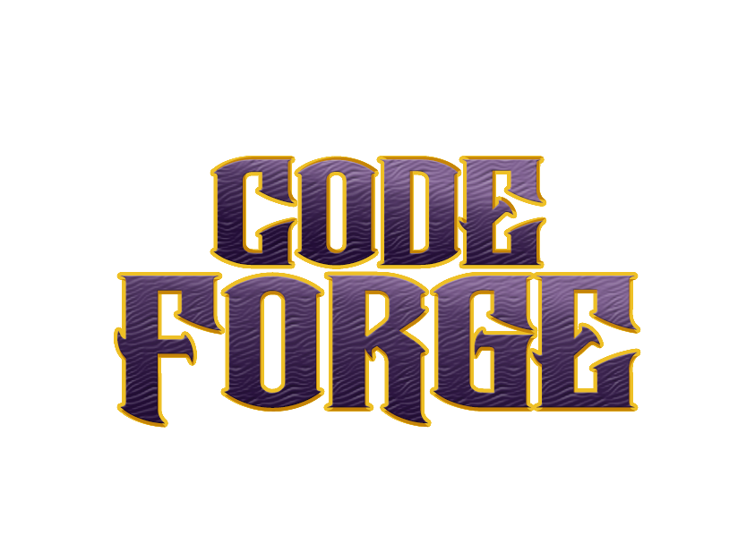

Idea submission

Slide 2


Team details
Team Lead: Name: Chaitanya Ravi
Contact: 8660877374
Email:chaitanyaravi.ad24@bmsce.ac.in
Team Member 2: Name:Moulya s
Contact: 8197618586
Email:moulyas.cs24@bmsce.ac.in
Team Member 3: Name: Shwetha
Contact: 8147179809
Email:

Slide 3


Our solution
The proposed browser extension enhances productivity by closing distracting tabs and enforcing focus rules. It blocks social media sites, only allows educational YouTube channels or videos with study-related keywords, and closes inactive tabs after 5 minutes. Additionally, it enforces a daily screen time limit for non-educational browsing.

Slide 4

TECHNICAL APPROACH
Technologies Used in the Solution Implementation
JavaScript & Chrome Extension API
YouTube API.
Local Storage API.
Regex & String Matching Algorithms
Event Listeners & Tab Monitoring

Slide 5
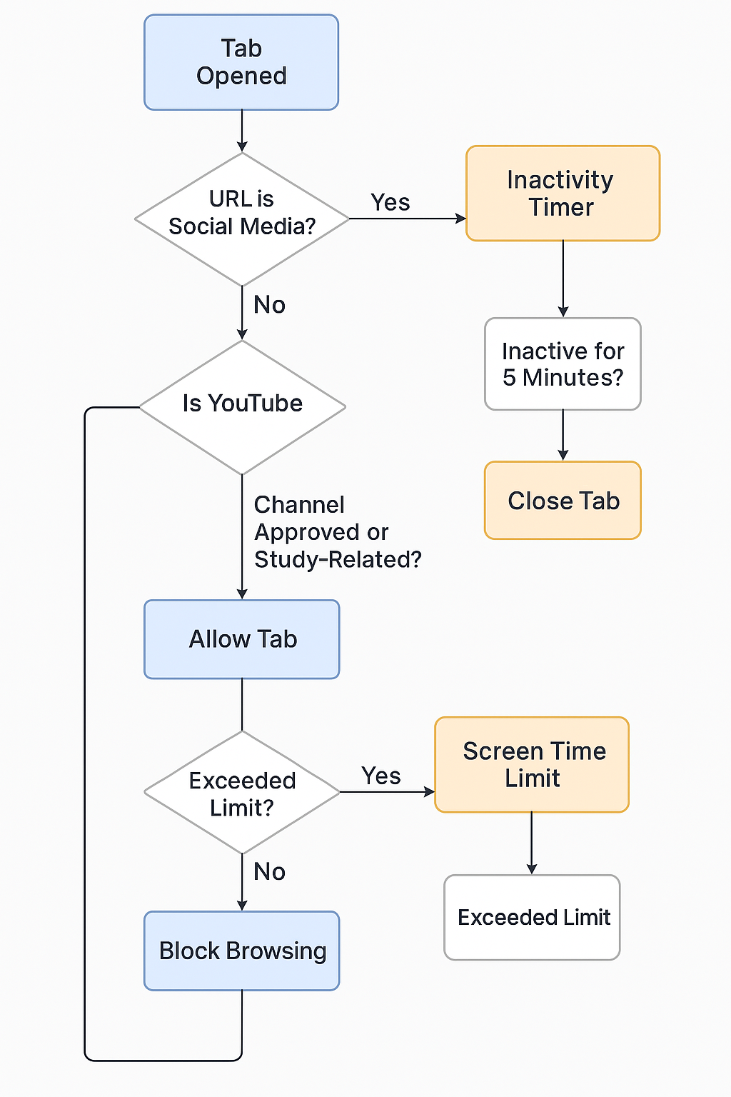
Workflow/pipeline

Slide 6
pros & cons
PROS
Adaptive Website Blocking Based on Mental State :If you're calm & focused, minor distractions (e.g., news, light entertainment) are allowed.
AI-Powered Distraction Monitoring : Tracks eye movement using the webcam: If you're frequently looking away, the extension warns you or suggests a break.
Personalized Study Boost Suggestions : If you're struggling to focus, the extension suggests scientifically-backed focus techniques, such as: Pomodoro reminders
AI-Powered Focus Reward System : When you stay productive, you earn focus points that can be redeemed for: Break time on entertainment websites
Automatic Posture & Health Warnings :If it detects bad posture or prolonged sitting, it gives ergonomic advice.
CONS
Potentially Harsh User Experience
False Positives & False Negatives
Privacy Concerns
Difficult Whitelist Management
Impact on Workflow

Slide 7
Future scope
AI-Powered ADHD & Cognitive Focus Detection System
1. Adaptive AI Productivity Score
Tracks user activity and assigns a productivity score based on the websites visited.
2. Focus-Boosting AI Chatbot
Integrate an AI assistant that encourages focus and provides motivational messages when distractions occur.
3.Study Session Playlist Generator
Creates custom background music playlists (lofi, binaural beats, white noise) based on the user’s study subject.
4.Smart Break Manager
Suggests physical exercises, stretches, or quick mental relaxation techniques during breaks.
5.Auto-Note Taker for Research
If the user visits an educational site, the extension could auto-save important points into a study notes section
6.Voice Command Control
Let users speak commands like:
"Start study mode!" → Blocks distractions

